Slide 1

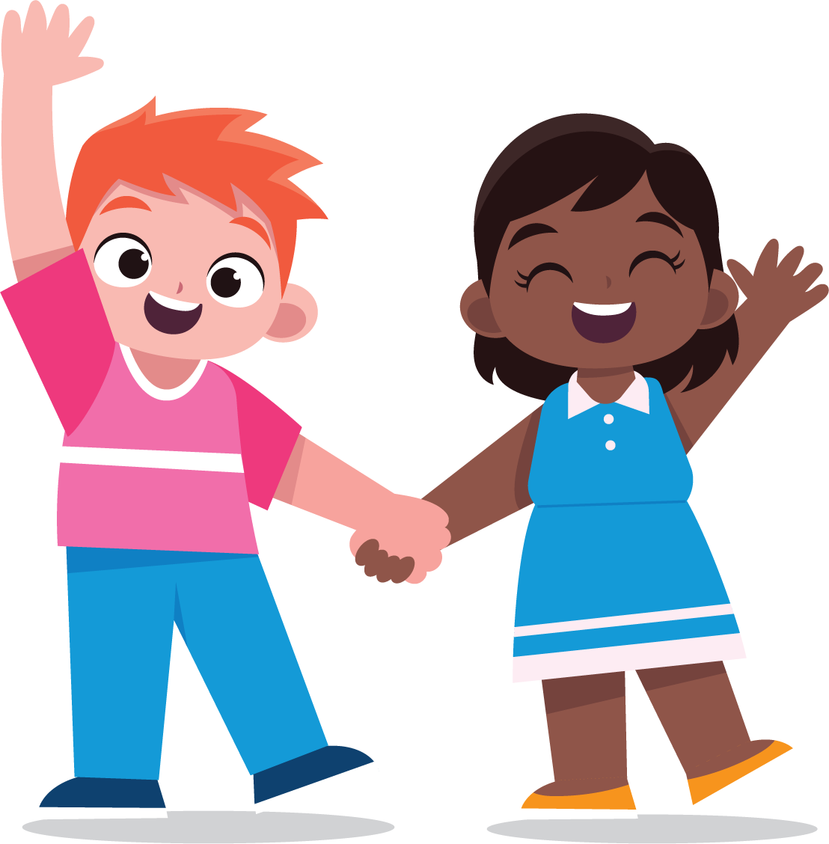

To Learn
About Consent
lausd.org/human-relations

Slide 2


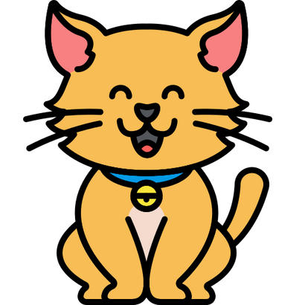
Would You Rather
Have a pet dog
Have a pet cat
lausd.org/human-relations

Slide 3
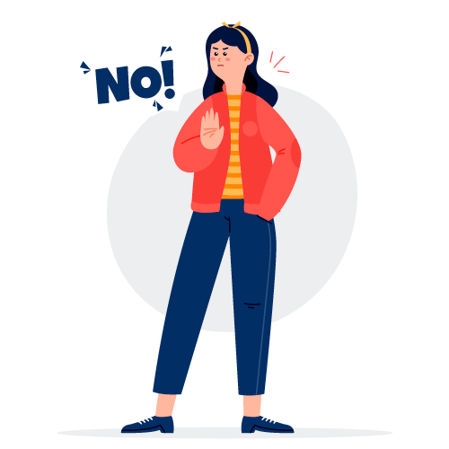
Pair Share
Have you heard the word consent before?
What does it mean?
lausd.org/human-relations

Slide 4


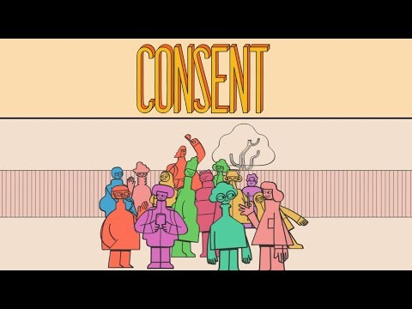
What is Consent?
lausd.org/human-relations
Notes:
https://youtu.be/AArIv-tvxWE

Slide 5
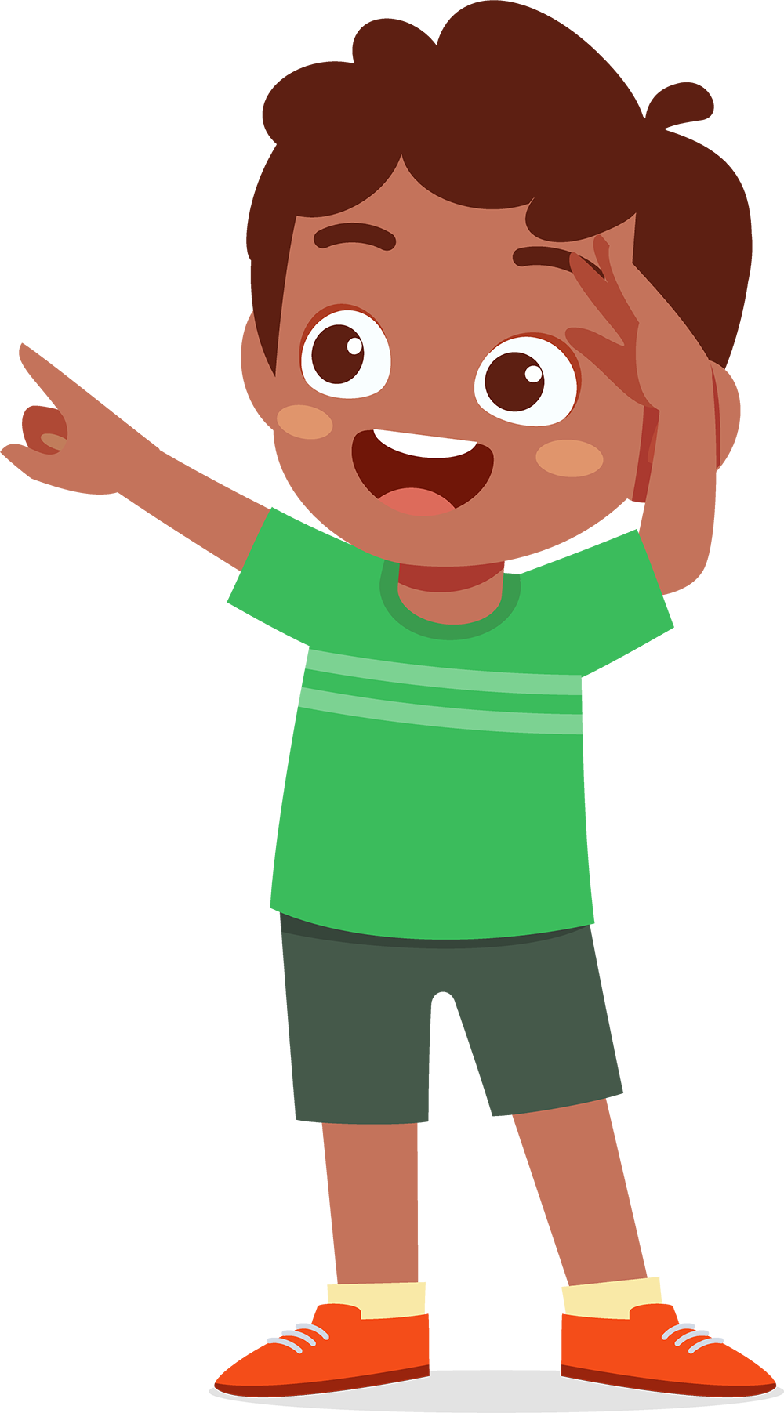
What Is Consent?
Consent is like permission.
Giving consent means you agree to let something happen
Should you eat a french fry off your friend's plate?
Only if you get permission first!
Should you post a picture with your bestie online?
Only if you get permission first!
lausd.org/human-relations

Slide 6

Pair Share
Asking first is how we make sure we have the consent, or permission, of the people we care about.
What kinds of things do you ask permission to do?
lausd.org/human-relations

Slide 7
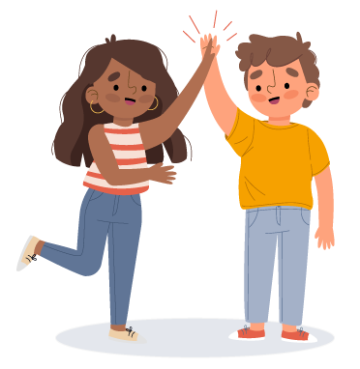
Hooray, I got Consent!
You asked permission to borrow your friend's soccer ball during recess. They said yes! You got consent!
You play with their soccer ball and have SO MUCH FUN!
lausd.org/human-relations
lausd.org/human-relations

Slide 8
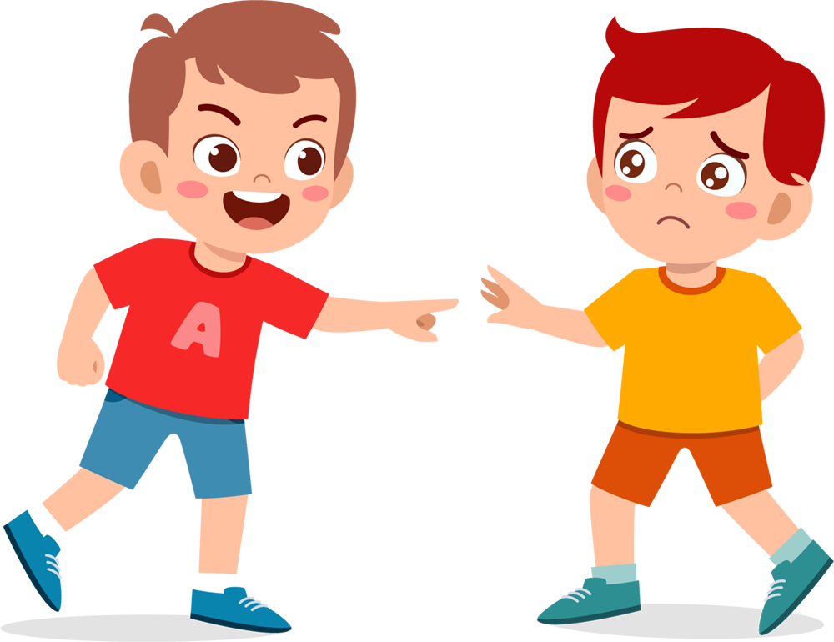
But then…
The next day, you just take their soccer ball to play with at recess without asking first.
Your friend gets upset.
Remember: just because they said yes one time, doesn't mean they will always say yes.
It's important to get consent every time!
lausd.org/human-relations
lausd.org/human-relations

Slide 9
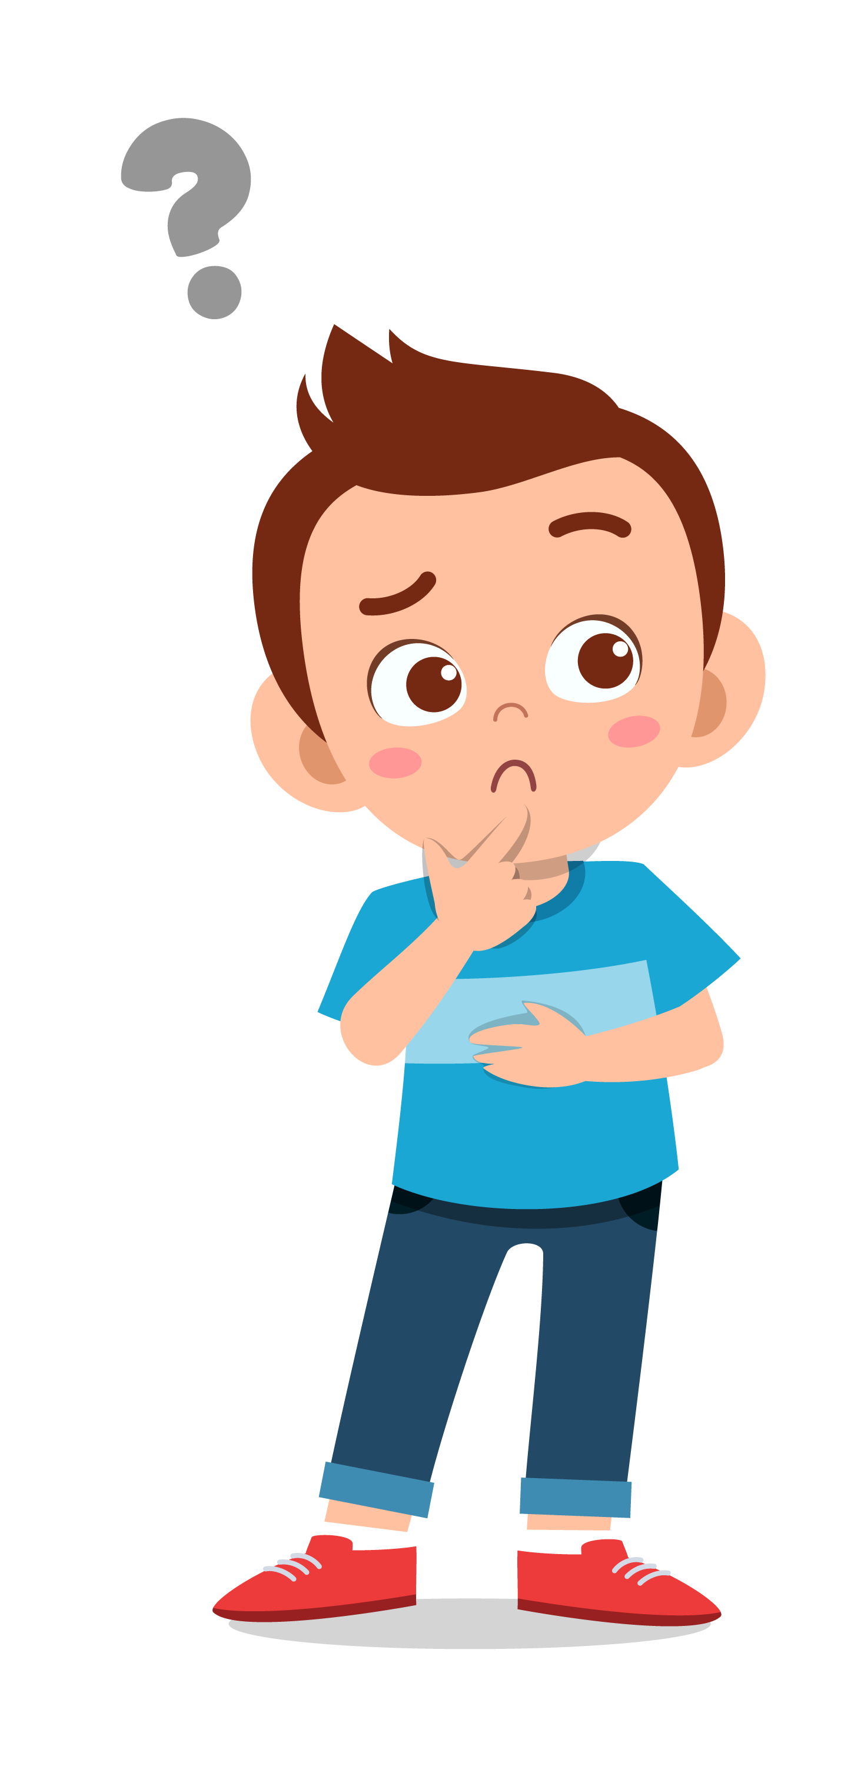
Pair Share
Can you think of a time you agreed to something and then changed your mind?
lausd.org/human-relations

Slide 10
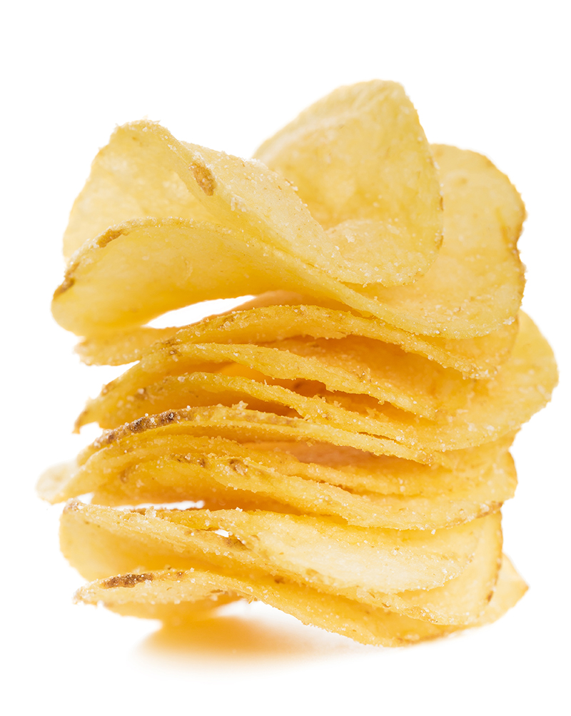
Bummer, No Consent
You ask your friend if you can have one of their chips at lunch.
They say "no".
You tell them that you love chips and they have so many!
They still say "no".
You did not get consent today.
lausd.org/human-relations

Slide 11
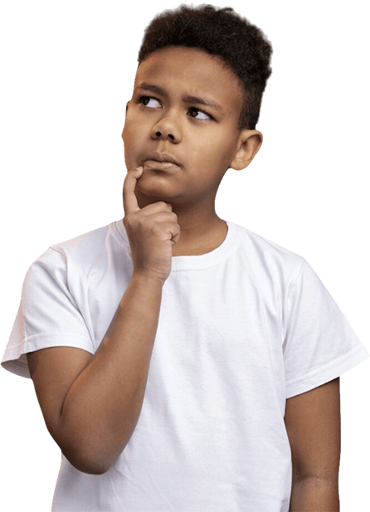
Remember:
Nobody has to give you a reason when they choose not to give consent.
If you don't get consent, that thing shouldn't happen.
No matter what.
lausd.org/human-relations

Slide 12
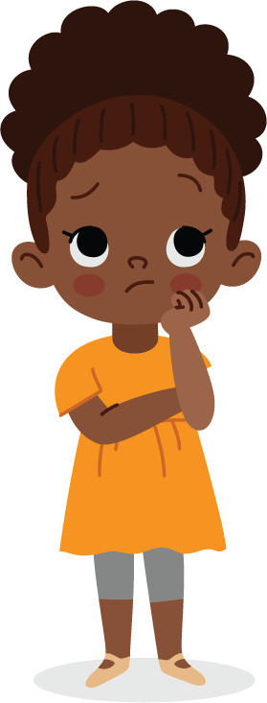
Pair Share
When you ask someone for something and they say no it can be a bummer.
How might it make you feel?
How can you help yourself feel better?
lausd.org/human-relations

Slide 13
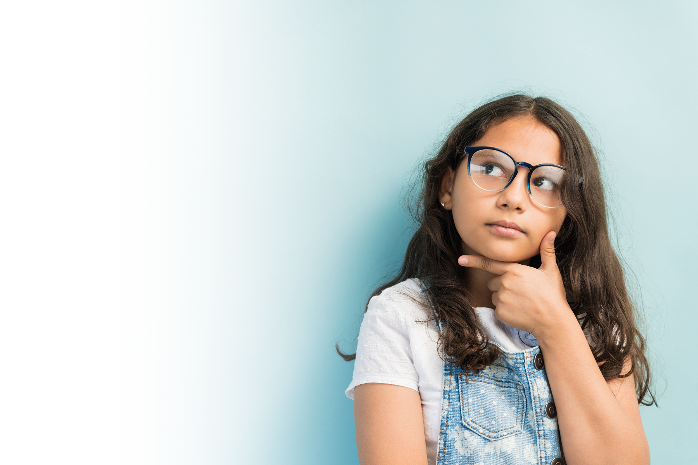
Practice Giving and Honoring Consent
You know you have made a choice to consent when you are:
Trusting the other person
Very sure about your decision
Comfortable changing your mind
lausd.org/human-relations

Slide 14
Phrases That Communicate Consent
Make a choice to check in with people about consent!
Useful phrases include:
Are you okay with me having one of your french fries?
Do you feel comfortable sharing your crayons with me?
How does it feel for you to sit somewhere else today?
Can I give you a hug/high five?
Let's talk about this later to see if we are still up for it.
lausd.org/human-relations

Slide 15

Discussion
How do you let people know that you are excited about something?
lausd.org/human-relations

Slide 16



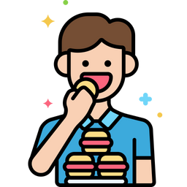

Check Out
What will you do for yourself today?
Wind down
Engage in calming
activities to decompress after school
Feed your spiritual self
Social
Spend quality time with special people
Eat well
Rest
lausd.org/human-relations

Slide 17
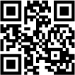
Committed to fostering a safe and respectful District, school and community culture where the seeds of peace and justice are down so that all students and staff can lead safe, purposeful and academically fruitful lives.
Connect with us at bit.ly/LAUSD-HRDE
lausd.org/human-relations

